Slide 1
Lesson 8
Variations, Variations, and More Variations
Activity 8.1: What do I do with all this data?
Activity 8.2: How can we show ranges of variation?
Activity 8.3: Variation everywhere, so what?
Activity 8.4: How do genes work for continuous traits?
Reading 8.4: Height—Unraveling a genetic puzzle

Slide 2
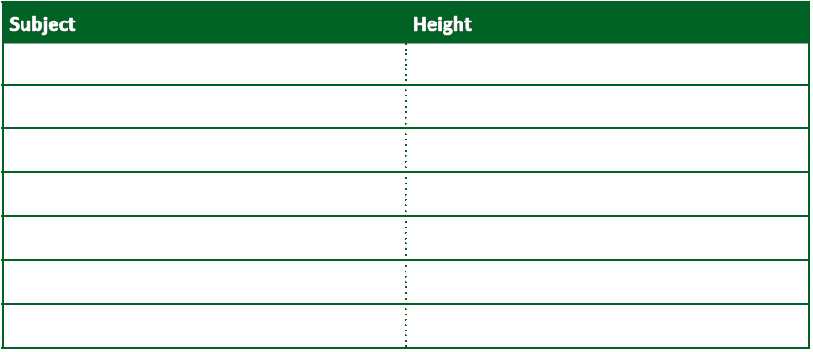
Representations—Data Table
Notes:
Strength/Weakness

Slide 3
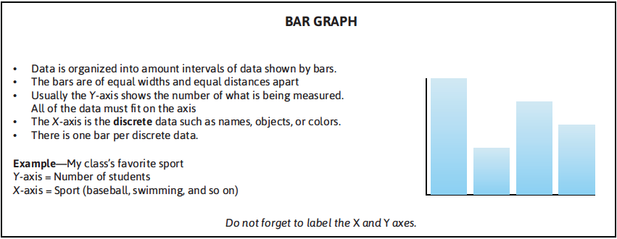
Representations—Bar Graph
Notes:
How would this work? One bar per person?

Slide 4
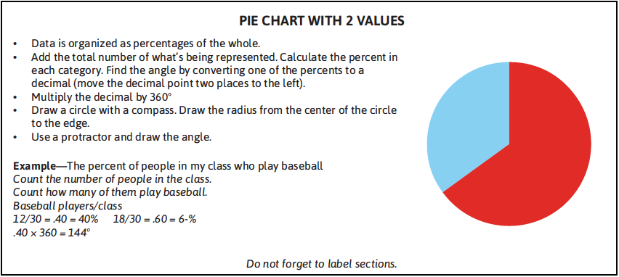
Representations—Pie Chart
Notes:
How would a pie chart work? Strength/Weakness

Slide 5
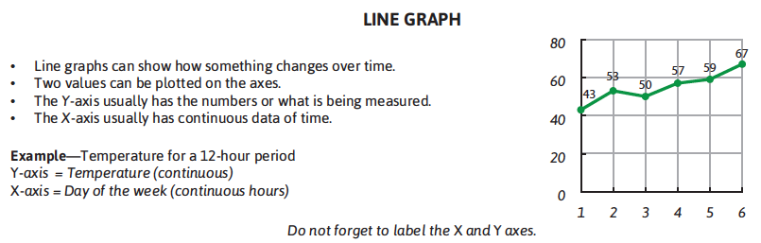
Representations—Line Graph
Notes:
How would this work?

Slide 6
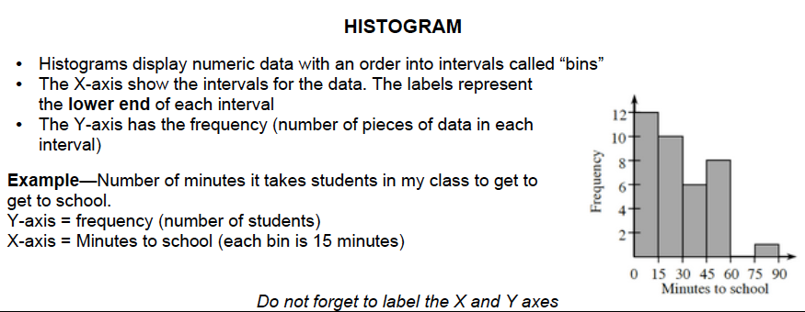
Representations—Histogram
Notes:
How would this work?

Slide 7
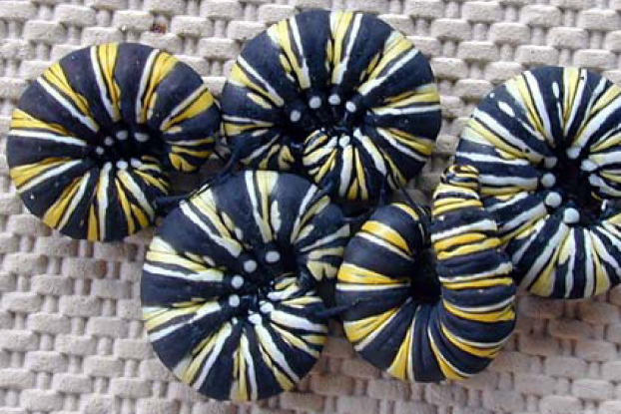
Monarch Butterfly Larva-Variations?

Slide 8
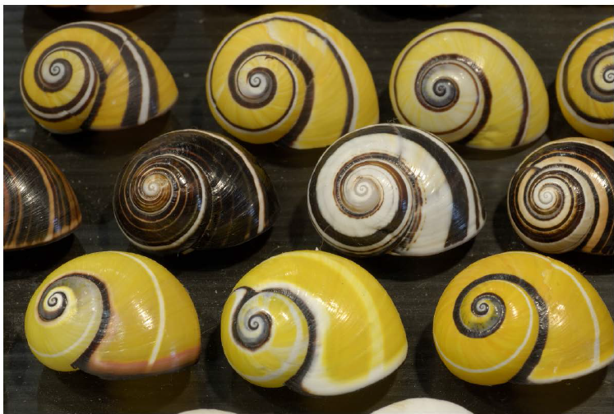
Snails—Variation?

Slide 9
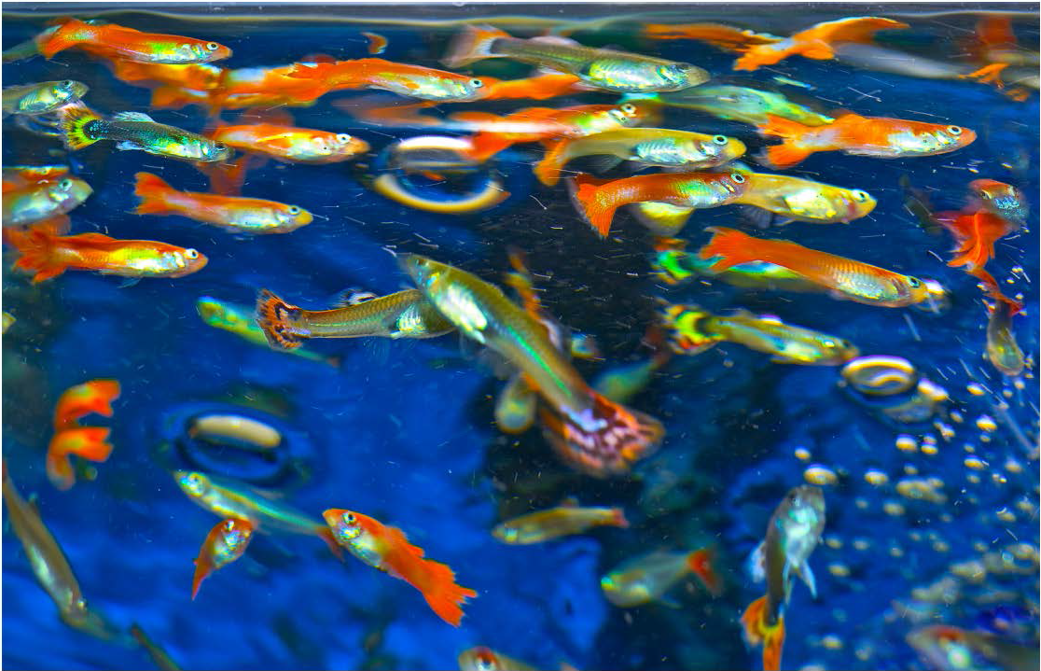
Guppies—Variation?

Slide 10
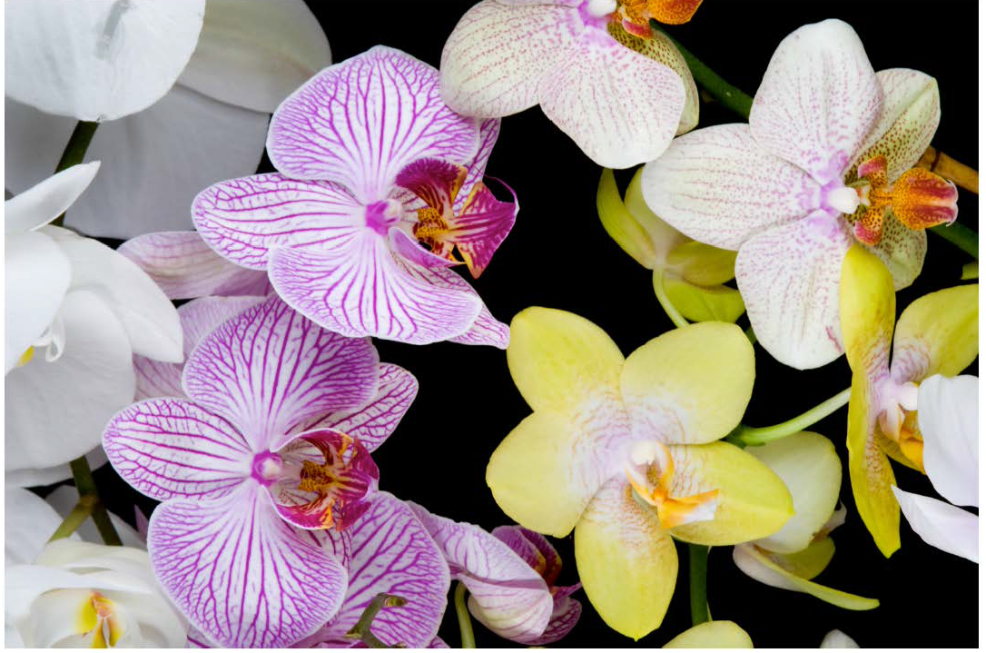
Orchids—Variations?

Slide 11
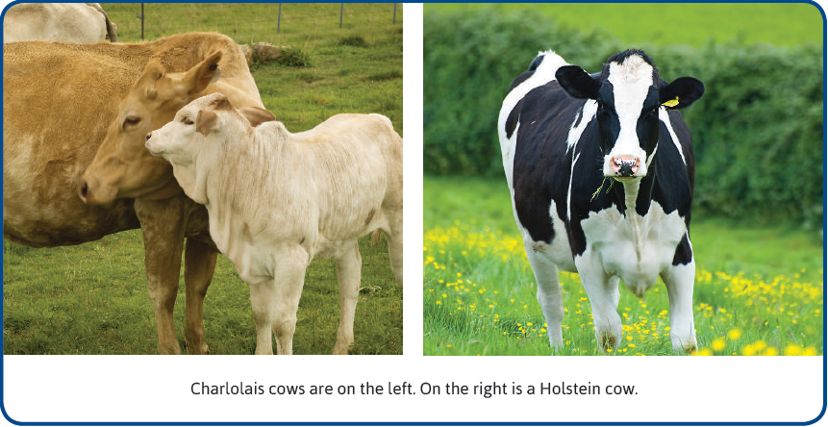
Activity 8.3 Part 2--Page 94

Slide 12
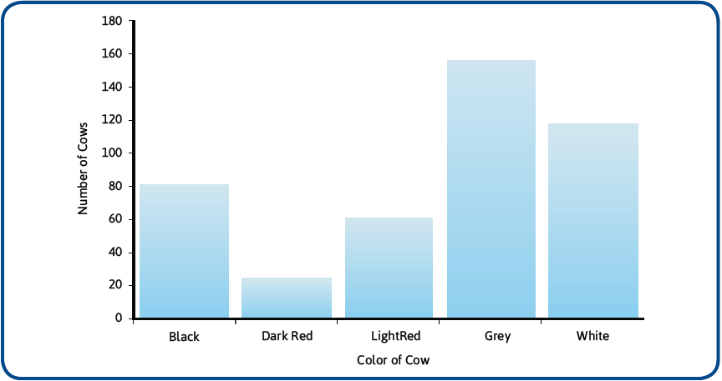
Color of Cow

Slide 13
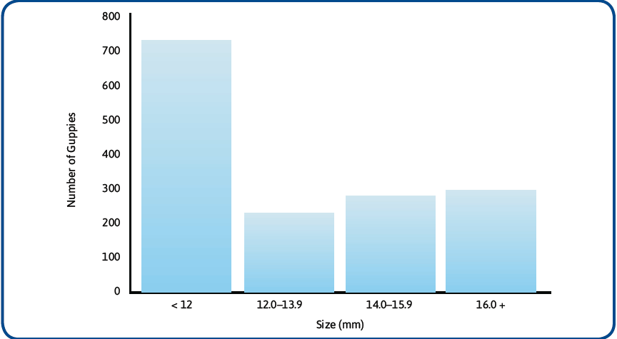
Guppy Size

Slide 14
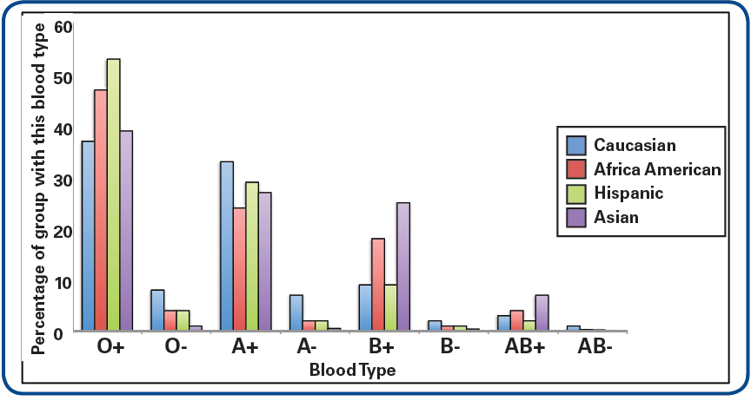
Blood Type

